Slide 1


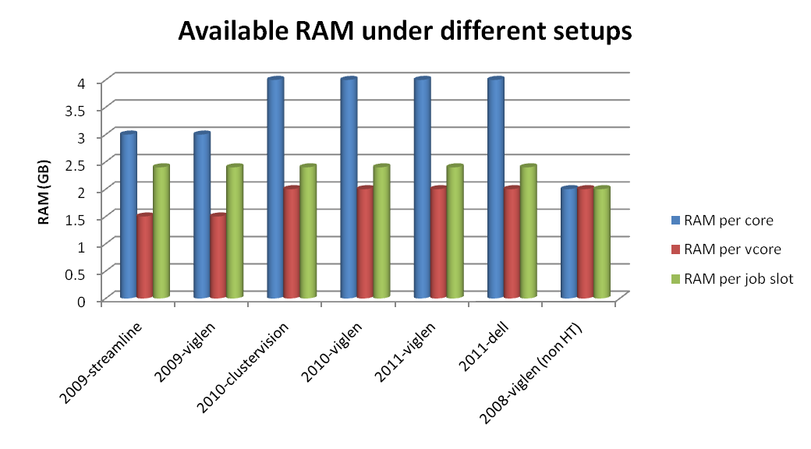
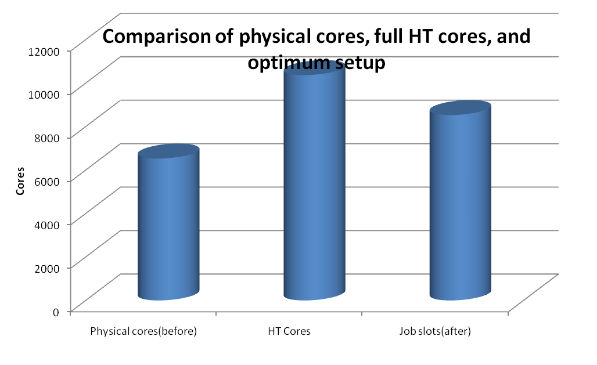


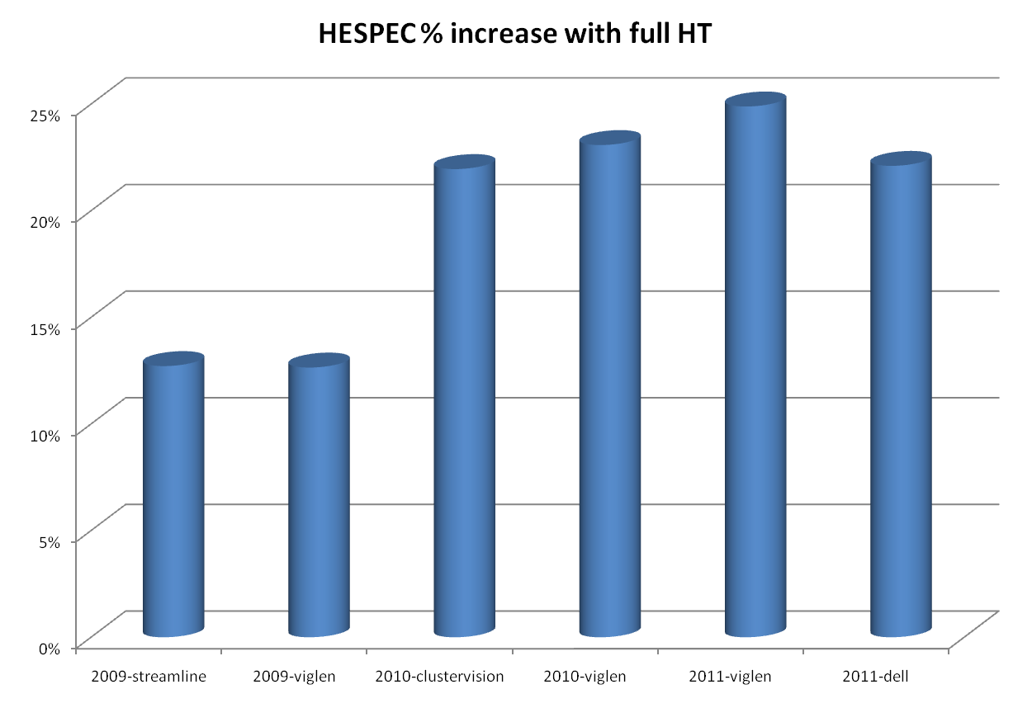
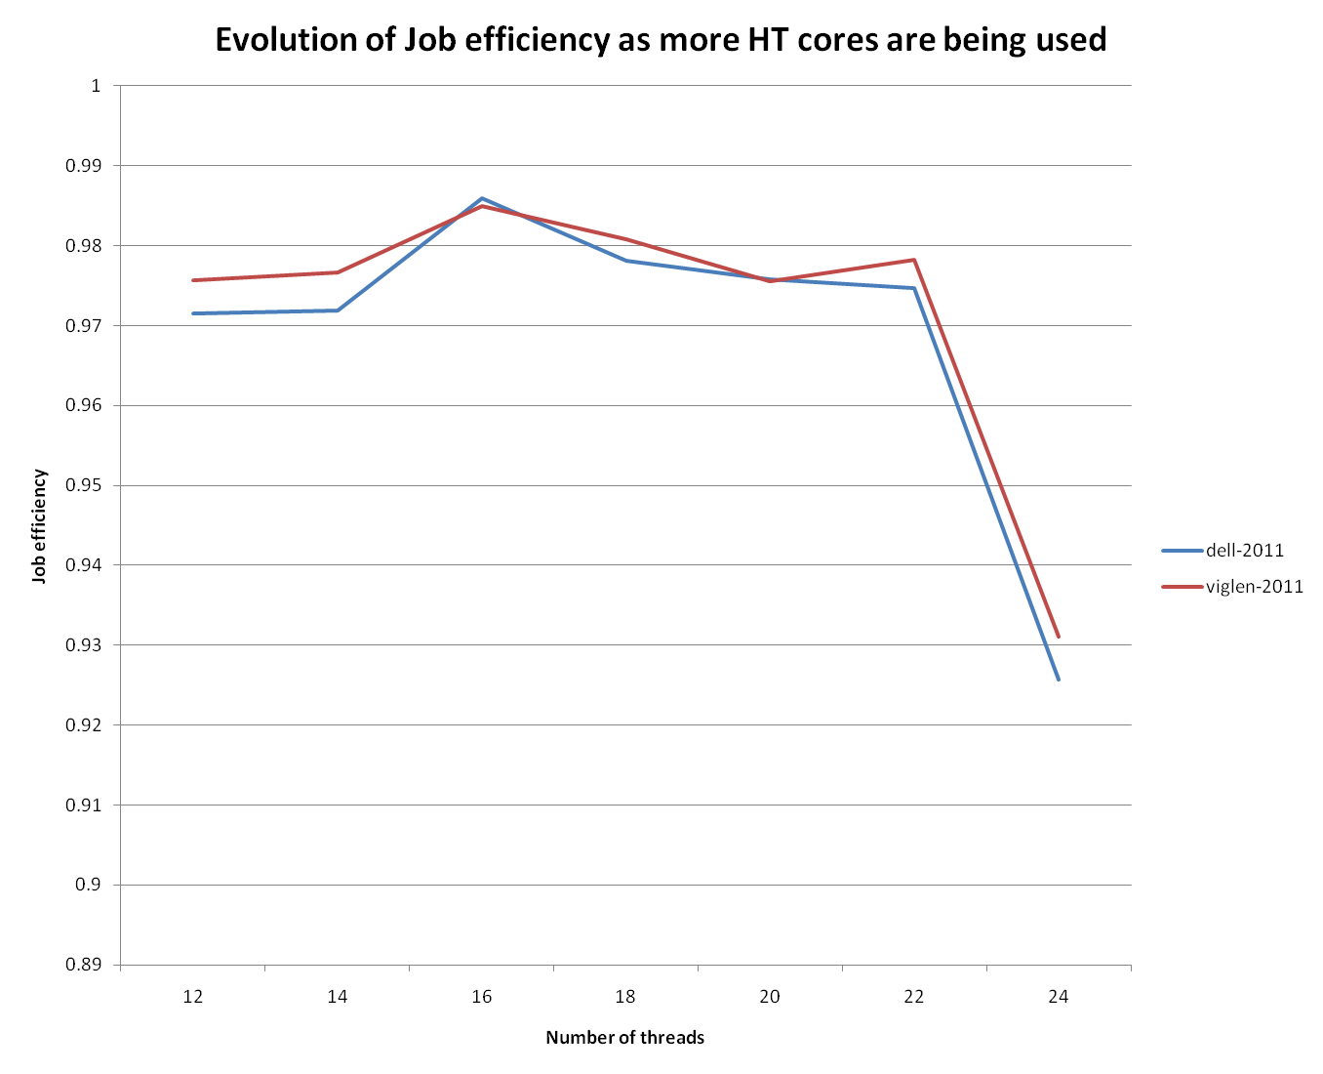

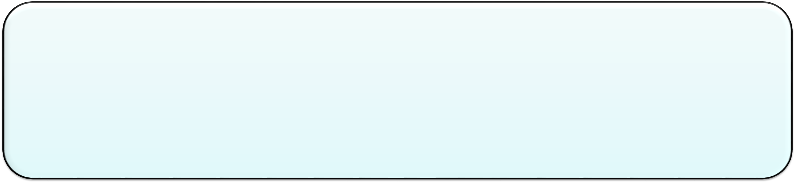


Title of the Poster
Supervised By: Prof.*********
Students WHO DID THE STUDY
UNIVERSITIES THEY ARE AFFILIATED WITH
  Abstract
  Methodology & System Setup
  The RAL TIER1 batch farm consists of several multicore, hyperthreading capable CPUs. Increases in the amount of memory per node combined with experiences from other sites made hyperthreading an attractive option for increasing job throughput.
  RAL supports all LHC VOs, with prime users being Atlas, CMS and LHCB, and a 10% of resources is devoted to non-LHC VOs
  The virtual cores provided by hyperthreading could double the batch farm capacity, however the amount of memory available in the batch nodes did not permit that. LHC jobs require more than 2GB RAM to run smoothly.
A poster is a visual support for discussion about your work with other scientists. This poster layout gives you some guidelines for the preparation of posters for NRSC2016.
This document provides a guideline for preparation of posters for the NRSC2016 and can be used as a template for the conference poster. The authors must produce the poster PowerPoint (PPT) file following this guideline or using this template, and print it in colour.
The poster must be printed on One Portrait page rollup with resolution of 4750*2000 pixels.
  Introduction
    Each generation of batch farm hardware with hyperthreading capability was benchmarked with HEPSPEC, progressively increasing the number of threads up to the total number of virtual cores
    Benchmarks at that time were conducted using Scientific Linux 5. Scientific Linux 6 benchmarks were run later as the batch farm was set to be
Results
  Overall, 2000 extra job slots and 9298 extra hepspec were added in the batch farm using already available hardware
  Average job time increases as expected, but overall job throughput increased
  Network/disk/power/temperature usage did not increase in a way that could negatively affect the overall throughput or require additional maneuvers
  Batch server was able to handle the extra job slots
  Of critical importance is the sharp drop in job efficiency as job slots approach the upper hyperthreading limit. This means that real world VO jobs would suffer if we went for full batchfarm HEPSPEC performance!
Make | Job Slots per WN | Efficiency | Average Job Length (mins) | Standard Deviation (mins) | Number of jobs
Dell | 12 | 0.9715 | 297 | 370 | 19065
Viglen | 12 | 0.9757 | 320 | 390 | 23864
Dell | 14 | 0.9719 | 238 | 326 | 6118
Viglen | 14 | 0.9767 | 270 | 341 | 11249
Dell | 16 | 0.9859 | 343 | 254 | 6550
Viglen | 16 | 0.985 | 304 | 249 | 8756
Dell | 18 | 0.9781 | 377 | 390 | 5014
Viglen | 18 | 0.9808 | 350 | 391 | 6263
Dell | 20 | 0.9758 | 318 | 346 | 11339
Viglen | 20 | 0.9756 | 260 | 285 | 11229
Dell | 22 | 0.9747 | 387 | 315 | 6317
Viglen | 22 | 0.9783 | 305 | 236 | 6307
Dell | 24 | 0.9257 | 544 | 373 | 6650
Viglen | 24 | 0.9311 | 372 | 278 | 6713
  System Parameters
  Conclusions
  New procurements now take into account the hyperthreading capabilities
  For 2012, dual 8 core CPU systems go up to 32 virtual cores
  Systems were procured with 128 GB RAM in order to exploit full hyperthreading capabilities
  Dual Gigabit links, in the future single 10 GB as they became more cost effective
  So far RAID0 software raid setup has proven sufficient for disk I/O
  Performance gains so far on par with previous generations
  By spending a bit extra on RAM, we save more by buying fewer nodes
  This also saves machine room space, cables, and power
  References
  Biography
  Details about each contributor and Personal Photo
33rd NATIONAL RADIO SCIENCE CONFERENCE (NRSC 2016), www.nrsc2016.aast.edu

